Slide 1
*

Slide 2
The What And When Of Salvation?
WHAT? |  | WHEN?

Slide 3
The What And When Of Salvation?
WHAT? |  | WHEN?
 | Remission of Sins

Slide 4
The What And When Of Salvation?
WHAT? |  | WHEN?
Blood (Heb. 9:22; 10:1-4) | Remission of Sins

Slide 5
The What And When Of Salvation?
WHAT? |  | WHEN?
Blood (Matt. 26:28) | Remission of Sins

Slide 6
The What And When Of Salvation?
WHAT? |  | WHEN?
Blood (Matt. 26:28) | Remission of Sins
 | Sins Washed Away

Slide 7
The What And When Of Salvation?
WHAT? |  | WHEN?
Blood (Matt. 26:28) | Remission of Sins
Blood (Rev. 1:5) | Sins Washed Away

Slide 8
The What And When Of Salvation?
WHAT? |  | WHEN?
Blood (Matt. 26:28) | Remission of Sins
Blood (Rev. 1:5) | Sins Washed Away
 | Purges Conscience

Slide 9
The What And When Of Salvation?
WHAT? |  | WHEN?
Blood (Matt. 26:28) | Remission of Sins
Blood (Rev. 1:5) | Sins Washed Away
Blood (Heb. 9:14) | Purges Conscience

Slide 10
The What and When Of Salvation?
WHAT? |  | WHEN?
Blood (Matt. 26:28) | Remission of Sins | Repent and Be Baptized (Acts 2:38)
Blood (Rev. 1:5) | Sins Washed Away
Blood (Heb. 9:14) | Purges Conscience

Slide 11
The What and When Of Salvation?
WHAT? |  | WHEN?
Blood (Matt. 26:28) | Remission of Sins | Repent and Be Baptized (Acts 2:38)
Blood (Rev. 1:5) | Sins Washed Away | Arise, and Be Baptized (Acts 22:16)
Blood (Heb. 9:14) | Purges Conscience

Slide 12
The What and When Of Salvation?
WHAT? |  | WHEN?
Blood (Matt. 26:28) | Remission of Sins | Repent and Be Baptized (Acts 2:38)
Blood (Rev. 1:5) | Sins Washed Away | Arise, and Be Baptized (Acts 22:16)
Blood (Heb. 9:14) | Purges Conscience | Baptism (1 Pet. 3:21)

Slide 13
The What And When Of Naaman’s Cleansing?
WHAT? | 2 Kings 5:10 | WHEN?
 | Flesh Shall Come Again To Thee

Slide 14
The What And When Of Naaman’s Cleansing?
WHAT? | 2 Kings 5:10 | WHEN?
Power of God | Flesh Shall Come Again To Thee

Slide 15
The What And When Of Naaman’s Cleansing?
WHAT? | 2 Kings 5:10 | WHEN?
Power of God | Flesh Shall Come Again To Thee | Go and wash in Jordan seven times

Slide 16
The What And When Of Naaman’s Cleansing?
WHAT? | 2 Kings 5:10 | WHEN?
Power of God | Flesh Shall Come Again To Thee | Go and wash in Jordan seven times
 | Thou shalt be clean

Slide 17
The What And When Of Naaman’s Cleansing?
WHAT? | 2 Kings 5:10 | WHEN?
Power of God | Flesh Shall Come Again To Thee | Go and wash in Jordan seven times
Power of God | Thou shalt be clean

Slide 18
The What And When Of Naaman’s Cleansing?
WHAT? |  | WHEN?
Power of God | Flesh Shall Come Again To Thee | Go and wash in Jordan seven times
Power of God | Thou shalt be clean | Go and wash in Jordan seven times

Slide 19
The Grace And Faith Of Naaman’s Cleansing
GRACE |  | FAITH
Power of God | Flesh Shall Come Again To Thee | Go and wash in Jordan seven times
Power of God | Thou shalt be clean | Go and wash in Jordan seven times

Slide 20
The Grace and Faith Of Salvation
GRACE |  | FAITH
Blood (Matt. 26:28) | Remission of Sins | Repent and Be Baptized (Acts 2:38)
Blood (Rev. 1:5) | Sins Washed Away | Arise, and Be Baptized (Acts 22:16)
Blood (Heb. 9:14) | Purges Conscience | Baptism (1 Pet. 3:21)

Slide 21
The Where Of Salvation?

Slide 22
Can Salvation Be Found
Everywhere and Anywhere?

Slide 23
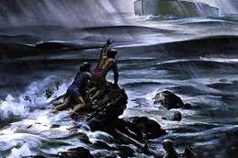
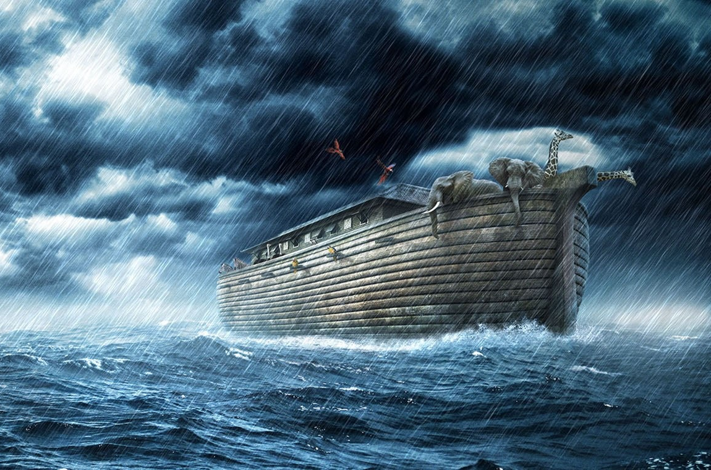
Where Was Salvation Found
When The Flood Came?
Any Other House
Noah's Ark

Slide 24
Where Was Salvation Found
During The 10th Plague?
House With The Blood Of The Lamb
Any Other House

Slide 25
Where Was Salvation Found
During The Battle Of Jericho?
Any Other House
Rahab's House W/ Scarlet Cord

Slide 26
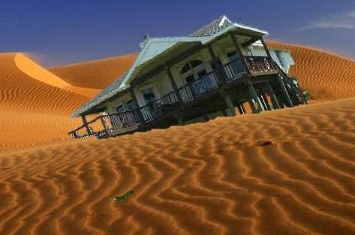
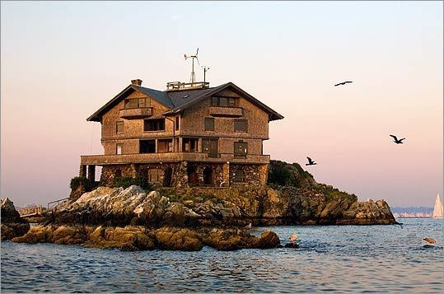
Where Would You Rather Be Found?
House Built On The Sand
House Built On The Rock

Slide 27
Where Can Salvation
Be Found Today?

Slide 28
Is One Church As Good As Another?

Slide 29
The Church Is The House Of God
Matthew 16:18
¹⁸ And I say also unto thee, That thou art Peter, and upon this rock I will build my church; and the gates of hell shall not prevail against it..
1 Timothy 3:15
But if I tarry long, that thou mayest know how thou oughtest to behave thyself in the house of God, which is the church of the living God, the pillar and ground of the truth.

Slide 30
Is One House As Good As Another?

Slide 31
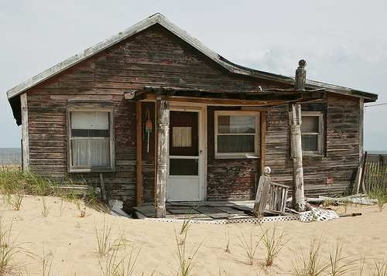
Is One House
As Good As Another?

Slide 32
Is One House As Good As Another?
House Built On The Sand
House Built On The Rock

Slide 33
Was One House As Good As Another
When The Flood Came?
Any Other House
Noah's Ark

Slide 34
Was One House As Good As Another During The 10th Plague?
House With The Blood Of The Lamb
Any Other House

Slide 35
Was One House As Good As Another During The Battle Of Jericho?
Any Other House
Rahab's House W/ Scarlet Cord

Slide 36
Eph. 5:23 “For the husband is the head of the wife, even as Christ is the head of the church: and he is the saviour of the body.”

Slide 37
Eph. 5:23 “For the husband is the head of the wife, even as Christ is the head of the church: and he is the saviour of the body.”
body of Christ

Slide 38
Eph. 5:23 “For the husband is the head of the wife, even as Christ is the head of the church: and he is the saviour of the body.”
body of Christ

Slide 39
Eph. 4:4 “There is one body, and one Spirit, even as ye are called in one hope of your calling.”
1
Eph. 5:23 “…he is the saviour of the body.”
body of Christ

Slide 40
Eph. 1:22-23 “…and gave him to be the head over all things to the church, Which is his body, the fulness of him that filleth all in all”
1
Eph. 5:23 “…he is the saviour of the body.”
body of Christ
Eph. 4:4- “There is one body”

Slide 41
Eph. 1:22-23 “…and gave him to be the head over all things to the church, Which is his body, the fulness of him that filleth all in all”
1
Eph. 5:23 “…he is the saviour of the body.”
church of Christ
Eph. 4:4- “There is one body”

Slide 42
Eph. 1:22-23 “…and gave him to be the head over all things to the church, Which is his body, the fulness of him that filleth all in all”
1
Eph. 5:23 “…he is the saviour of the body.”
church of Christ
Eph. 4:4- “There is one body”

