Slide 1
HEART, MIND, & SOUL
27 King Agrippa, do you believe the prophets? I know that you do believe.” 28 Then Agrippa said to Paul, “You almost persuade me to become a Christian.” 29 And Paul said, “I would to God that not only you, but also all who hear me today, might become both almost and altogether such as I am, except for these chains.” (Acts 26:27 – 29)

Slide 2
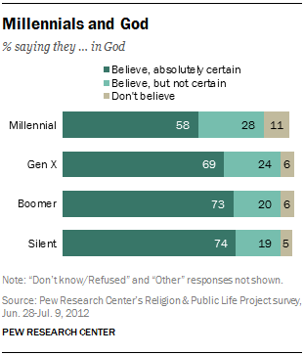

Slide 3
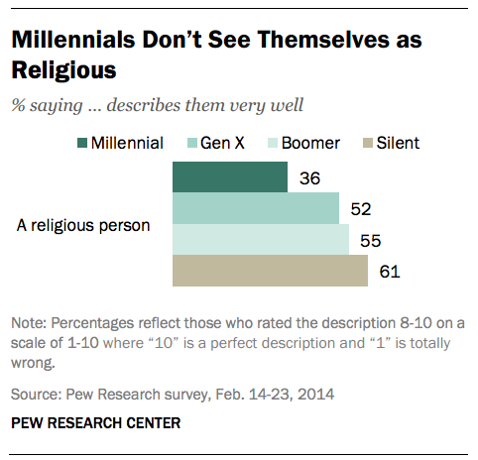

Slide 4
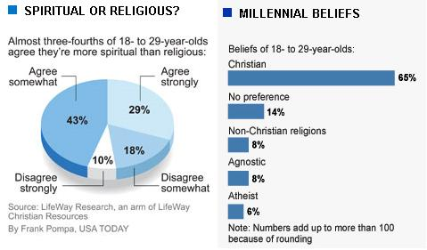

Slide 5
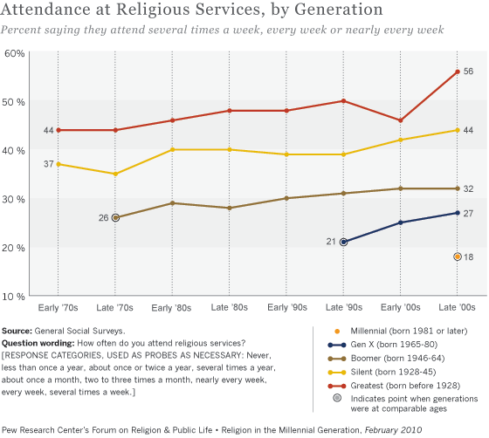

Slide 6

We have to win the intellectual discussion.
Matthew 28:19 – 20
I Peter 3:15 – 17
II Timothy 4:2

Slide 7

What does it takes to win the Heart?
Sinners need to see Authentic Faith in us:
Authentic Faith is committed.
Authentic Faith is active.
Authentic Faith is empathic.
Authentic Faith is honest about it’s own shortcomings.

Slide 8
Does your faith need to be renewed?
10 Create in me a clean heart, O God, And renew a steadfast spirit within me. 11 Do not cast me away from Your presence, And do not take Your Holy Spirit from me. 12 Restore to me the joy of Your salvation, And uphold me by Your generous Spirit. 13 Then I will teach transgressors Your ways, And sinners shall be converted to You. (Psalm 51:10 – 13)

