Slide 1
Jesus, the I AM
13 Then Moses said to God, “Indeed, when I come to the children of Israel and say to them, ‘The God of your fathers has sent me to you,’ and they say to me, ‘What is His name? ’ what shall I say to them?” 14 And God said to Moses, “I AM WHO I AM.” And He said, “Thus you shall say to the children of Israel, ‘I AM has sent me to you.’”
- Exodus 3:13 – 14

Slide 2
What’s God saying about himself?
He is speaking of His eternally.
He is speaking of His omnipresent.
He is speaking of His Authority.
He is speaking of His Power.
He is speaking of His Oneness.

Slide 3
Jesus is God
Genesis 1:26 – 27
John 1:1 – 4
John 1:14
Colossians 1:15 – 18
Jesus is the I AM!

Slide 4
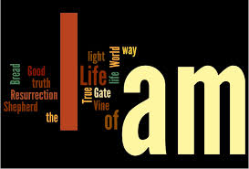
Jesus is the I AM!
The Seven I AM statements of Jesus Christ

Slide 5
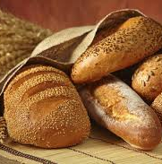
The Bread of Life
John 6:30 – 40
John 6:41 – 42
John 6:48 – 51

Slide 6
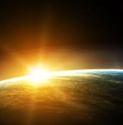
The Light of the world
John 8:12

Slide 7
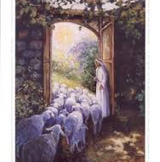
The Door of the Sheep
John 10:7 – 10

Slide 8
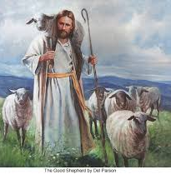
The Good Shepherd
John 10:11 – 18

Slide 9
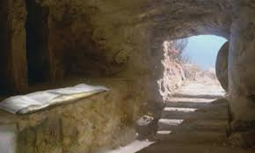
The Resurrection and the Life
John 11:20 – 27

Slide 10
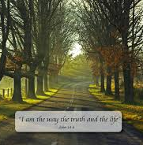
The Way, the Truth, and the Life
John 14:1 – 6

Slide 11
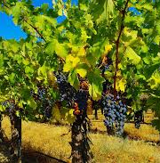
The Vine
John 15:1 – 8

Slide 12
Can you say, “I am a Christian?”
26 And when he had found him, he brought him to Antioch. So it was that for a whole year they assembled with the church and taught a great many people. And the disciples were first called Christians in Antioch.
- Acts 11:26

