Slide 1
JOHN 14:6
WHAT IS TRUTH?
A search for Truth
Notes:
This presentation demonstrates the new capabilities of PowerPoint and it is best viewed in Slide Show. These slides are designed to give you great ideas for the presentations you’ll create in PowerPoint 2011!
For more sample templates, click the File menu, and then click New From Template. Under Templates, click Presentations.

Slide 2
ATTACKS AGAINST TRUTH
Letty Russell, a postmodern feminist theologian, has argued that though “there are plenty of persons and churches still laying claim to God’s preference for their form of Christianity, the discovery of the whole inhabited world and the many faiths of that world has made the claim to salvation for only a few seem less and less credible” (1993, p. 120).
According to Richard Dawkins, “religion is very largely an enemy of truth” (Bass, p. 87).

Slide 3
Jesus said to him, “ I am the way, the truth, and the life. No one comes to the Father except through Me.”
JOHN 14:6

Slide 4
A BIBLICAL VIEW OF TRUTH
1
2
3
Seeking the Truth
Accepting the Truth
Proclaiming the Truth
“I am the Way, the Truth, and the Life…” John 14:6

Slide 5
SEEKING THE TRUTH
1
ACTS 17:10 – 12

Slide 6
10 Then the brethren immediately sent Paul and Silas away by night to Berea. When they arrived, they went into the synagogue of the Jews.
11 These were more fair-minded than those in Thessalonica, in that they received the word with all readiness, and searched the Scriptures daily to find out whether these things were so.
12 Therefore many of them believed, and also not a few of the Greeks, prominent women as well as men.
ACTS 17:10 – 12

Slide 7
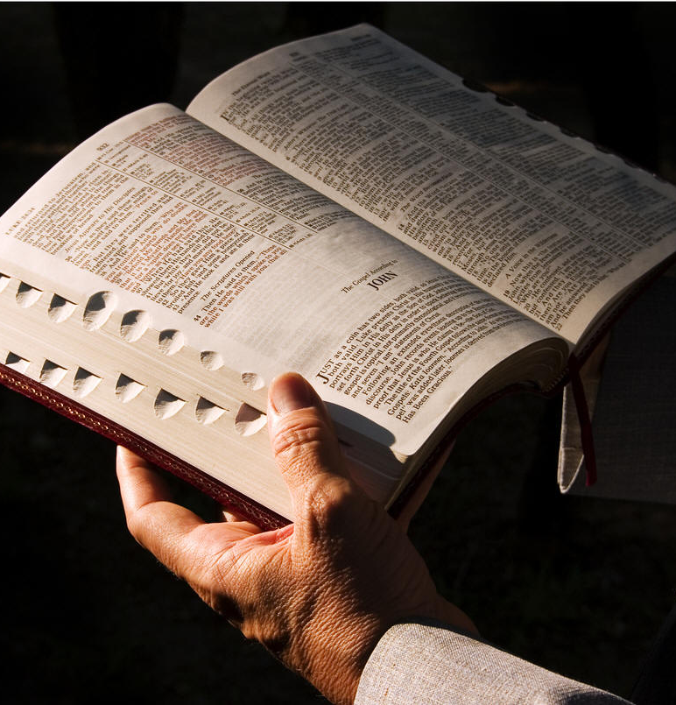
SEEKING TRUTH
John 17:17 – 19
Psalm 119:160
John 14:6

Slide 8

ACCEPTING THE TRUTH
2
I Corinthians 2:6 – 9

Slide 9

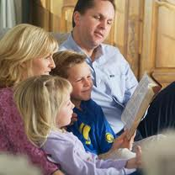
GROWING UP IN THE LORD
I Corinthians 2:6 – 9
Acts 2:42
I Timothy 4:12 – 16
II Timothy 3:14 – 15
Deuteronomy 6:4 – 9

Slide 10
PROCLAIMING THE TRUTH
3
Hebrews 10:14 – 15

Slide 11

PROCLAIMING THE TRUTH
Hebrews 10:14 – 15
John 4:35
Matthew 9:37, 38
I Corinthians 3:6, 7

Slide 12
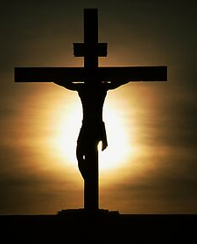
DEFENDING THE TRUTH
I Peter 3:15
Matthew 7:15
Acts 20:29 – 30
Galatians 2:11 – 16
Ephesians 4:15
Matthew 5:39 – 42
Galatians 6:1
James 5:19, 20

Slide 13
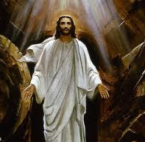
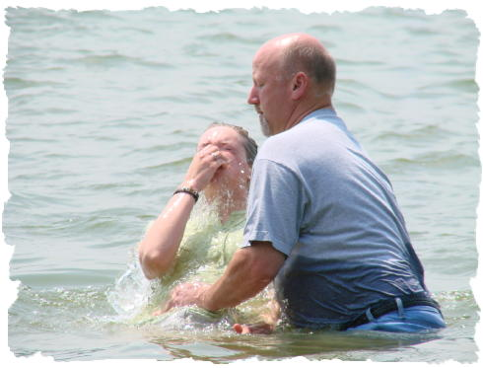
THE GOSPEL CALL
Believe
Obey
  Repent
  Be Baptized
Confess
Finish the Course

Slide 14





GOD IS TRUTH
HOW WILL YOU RESPOND TO HIS CALL?

